Slide 1
Assiengment:Implement a UI Policy on the Incident table to ensure the "Assigned to" field is mandatory for all active states except 'New' and 'Resolved'.

Slide 2
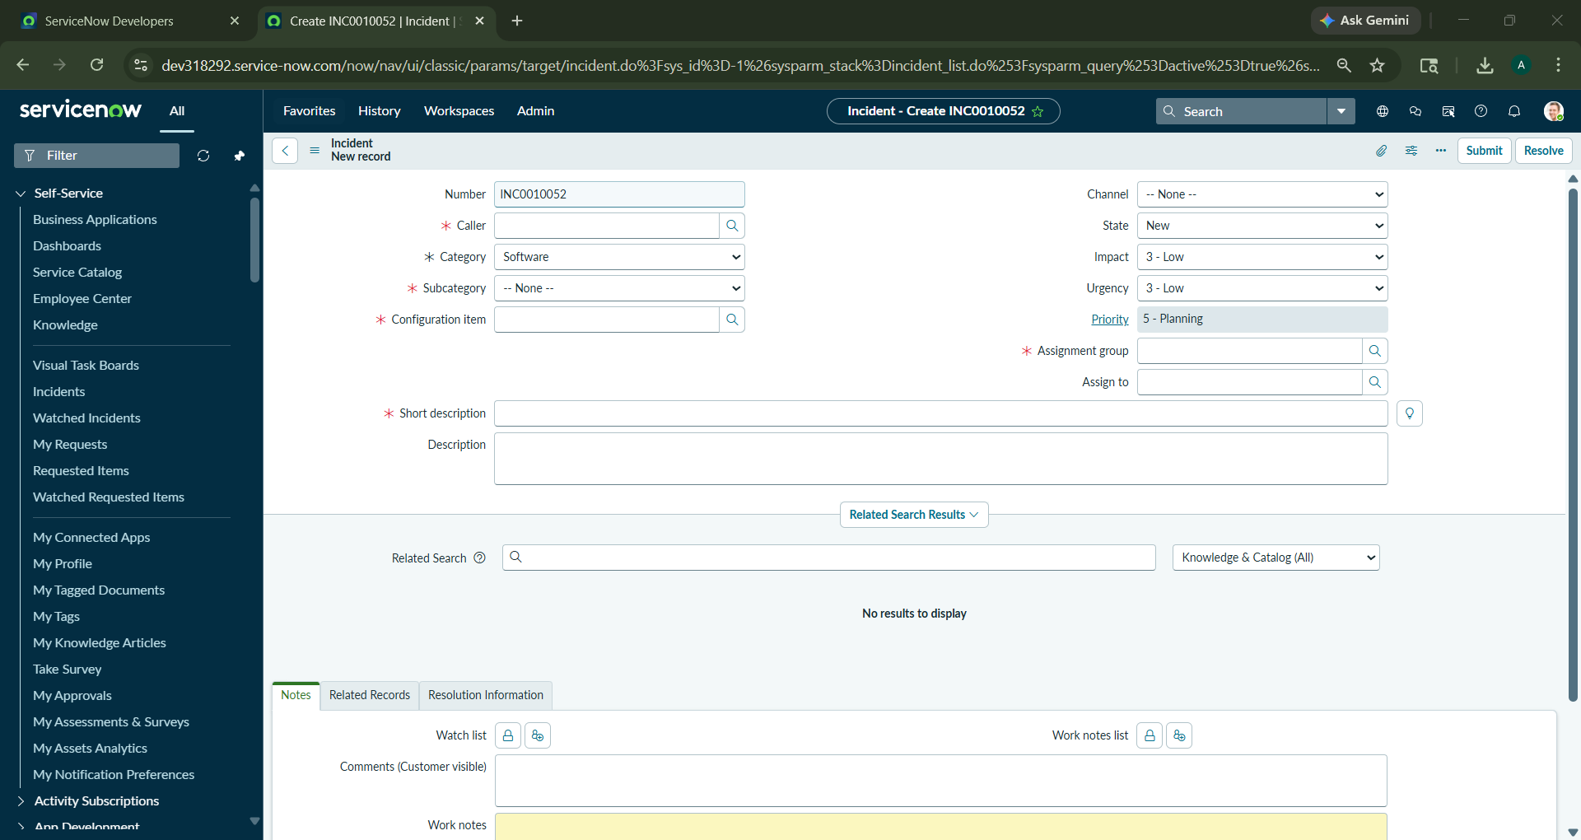
Step1 : Accessing the Incident form within the ServiceNow Personal Developer Instance (PDI) to begin configuration.

Slide 3
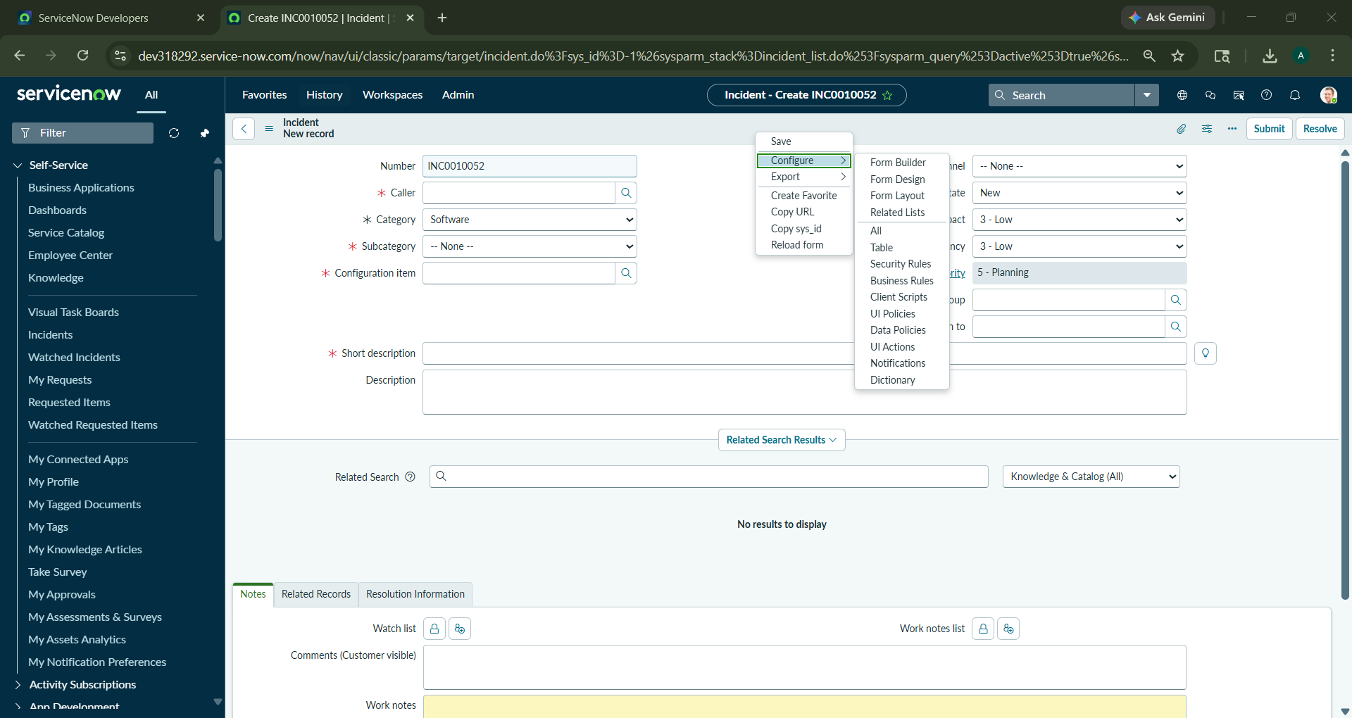
Step 2: Utilizing the form context menu to navigate to the UI Policies list for the Incident table.

Slide 4
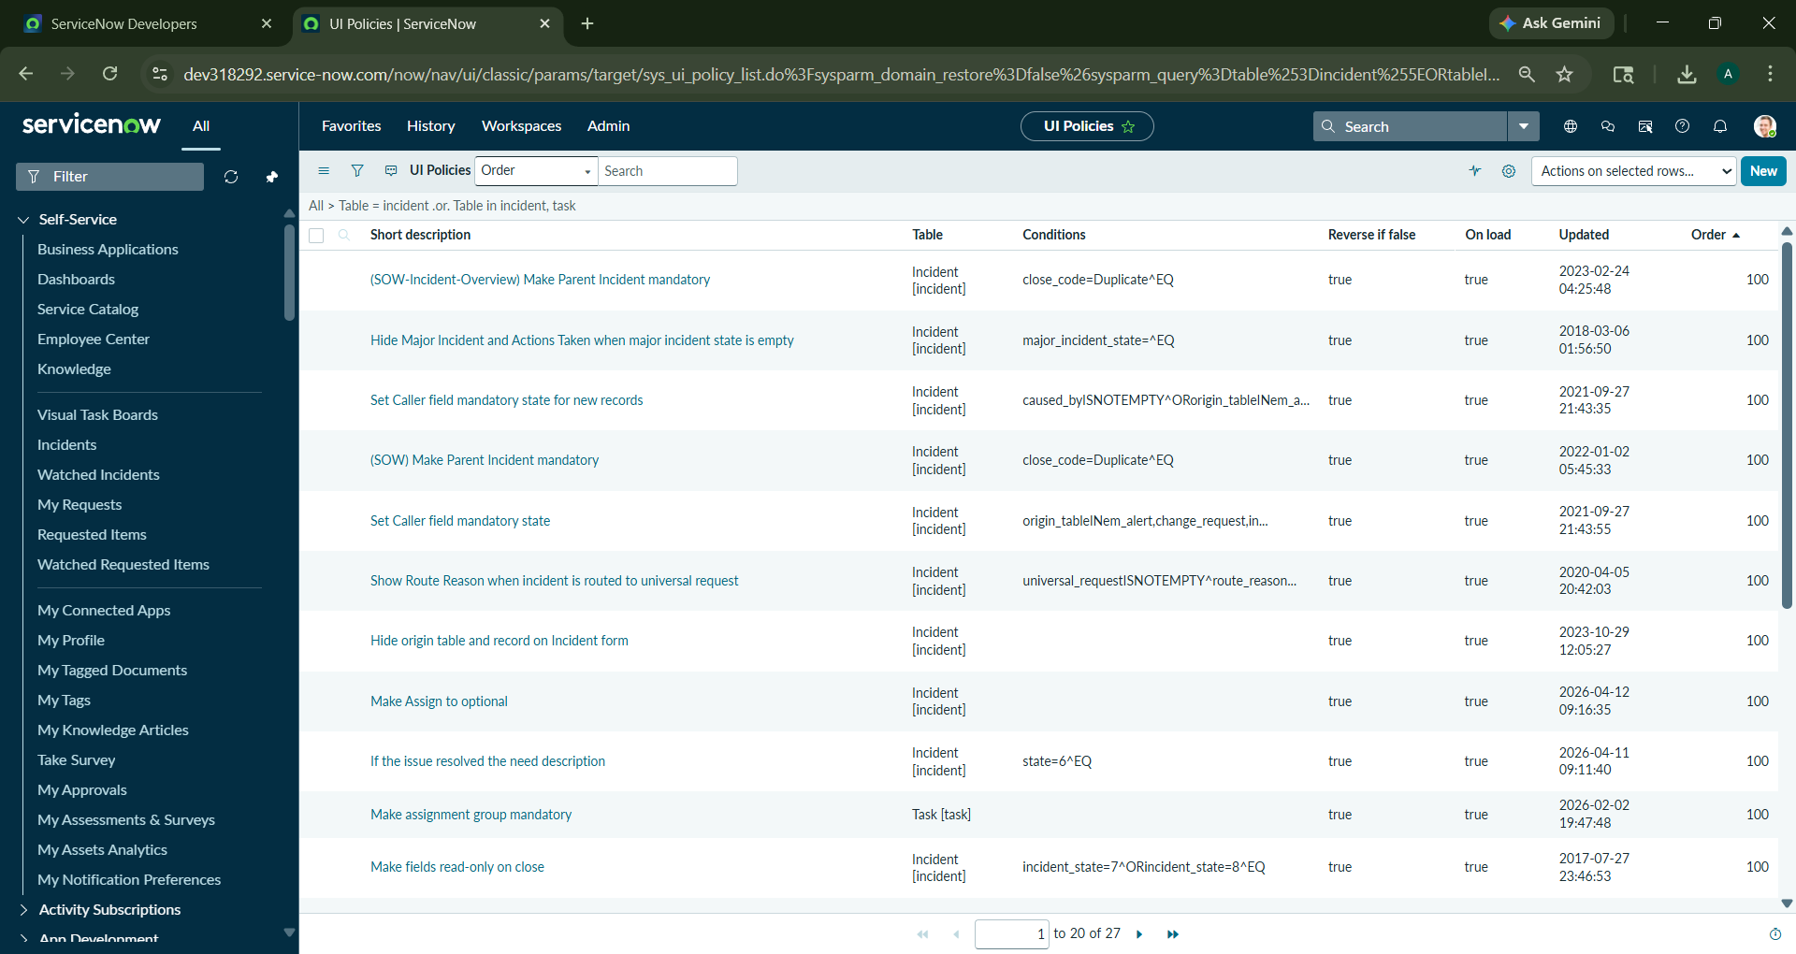
Step 3: Selecting 'New' to define a custom UI Policy governing field behaviors.

Slide 5
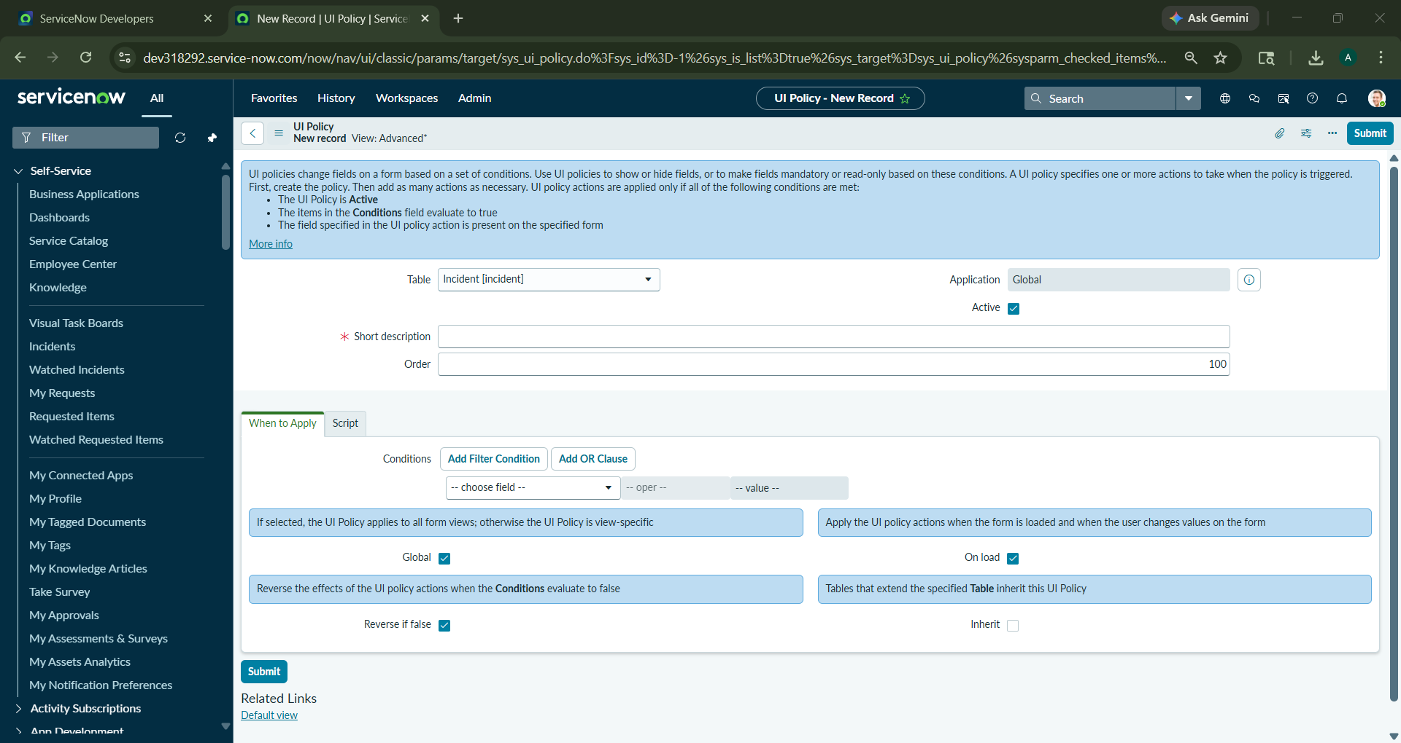
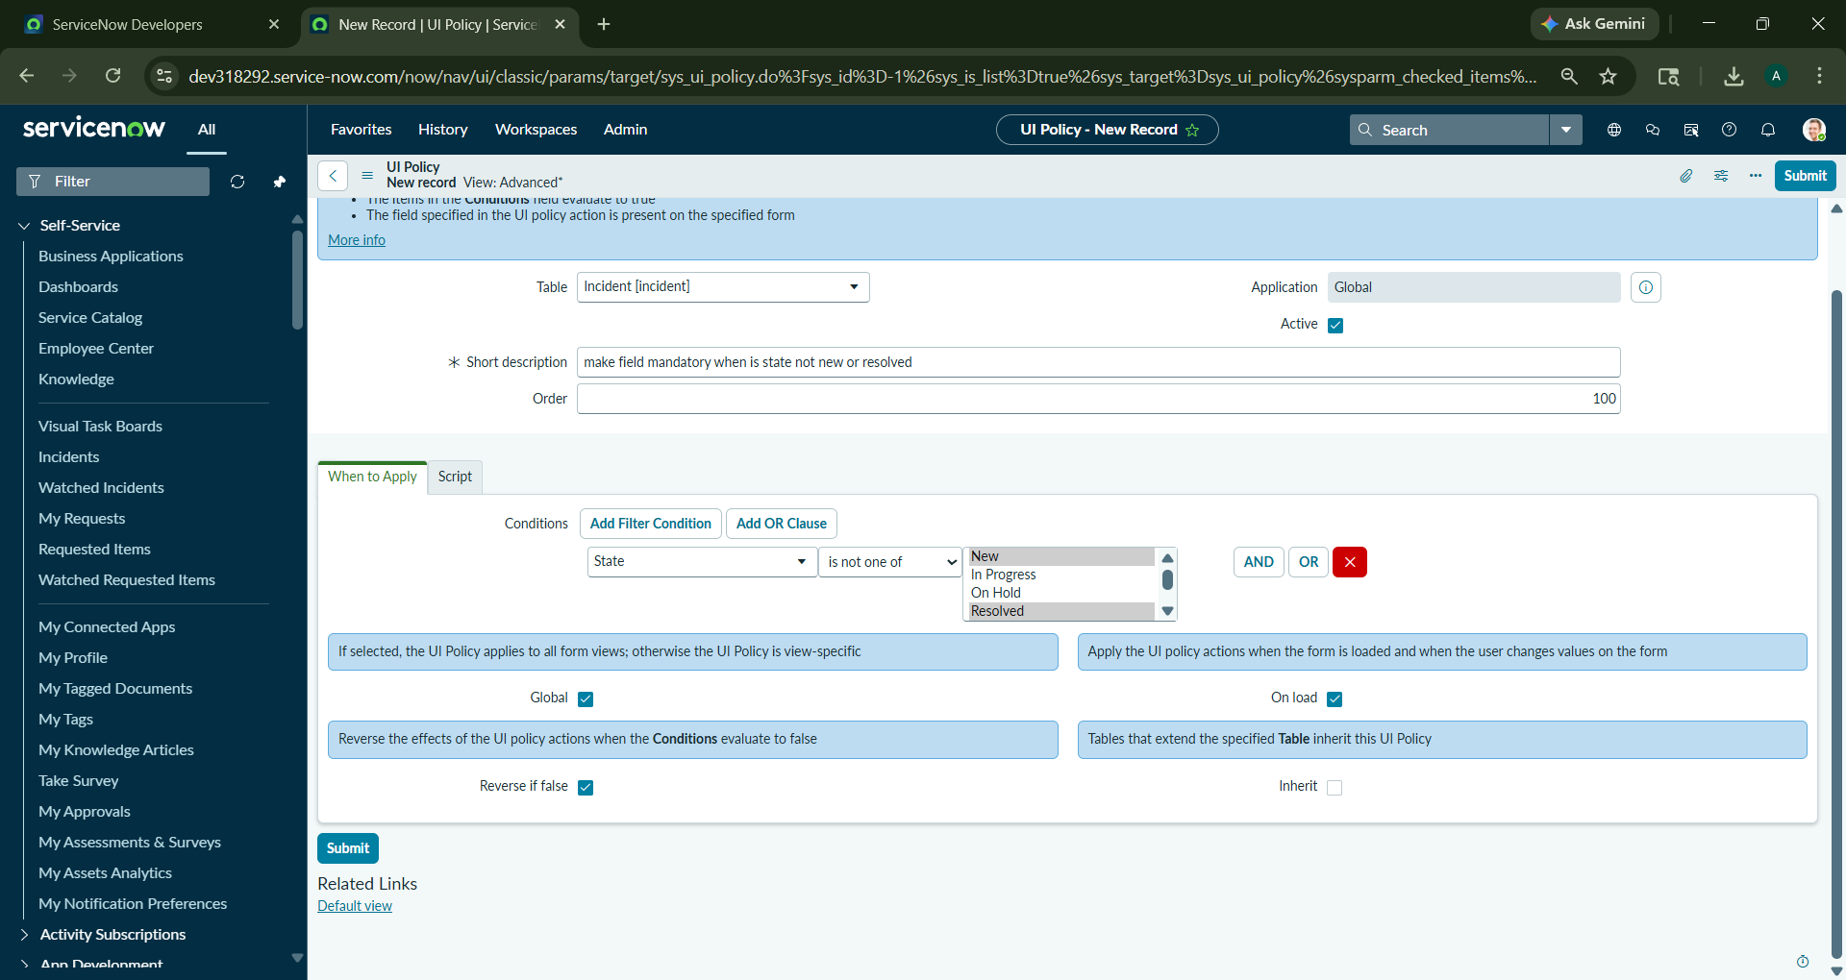
Step 4: Table: Incident [incident]. Short Description: Mandatory Assigned to – Active States. Conditions: State is not one of 'New' or 'Resolved'.

Slide 6
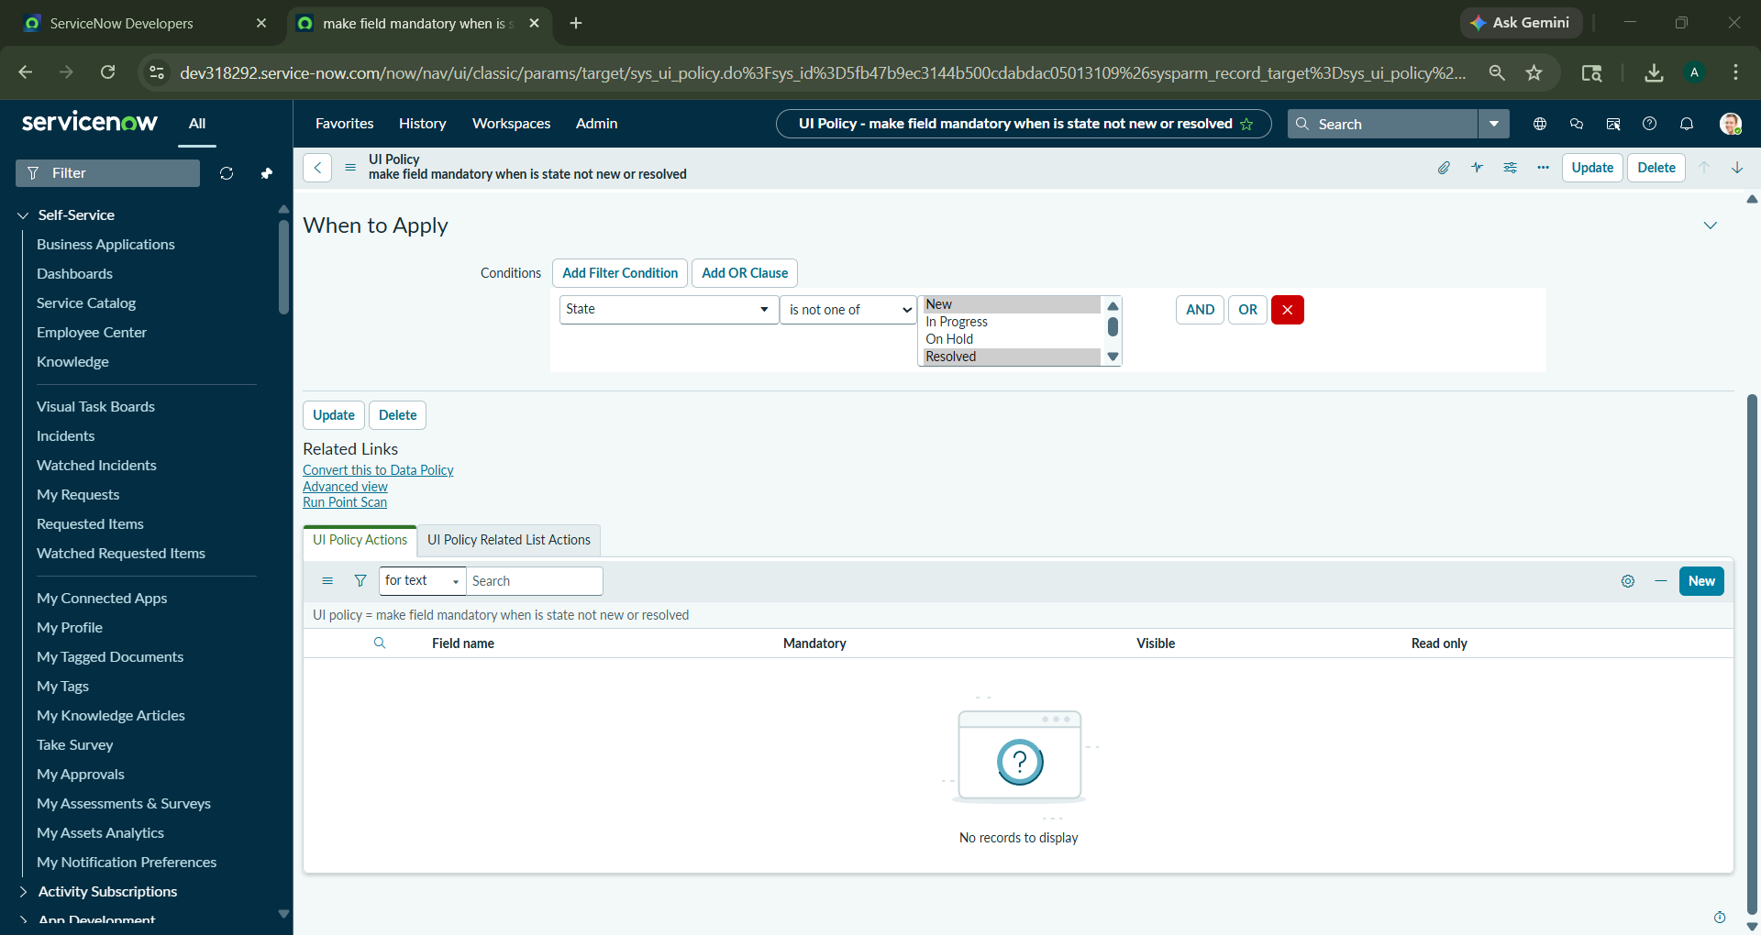
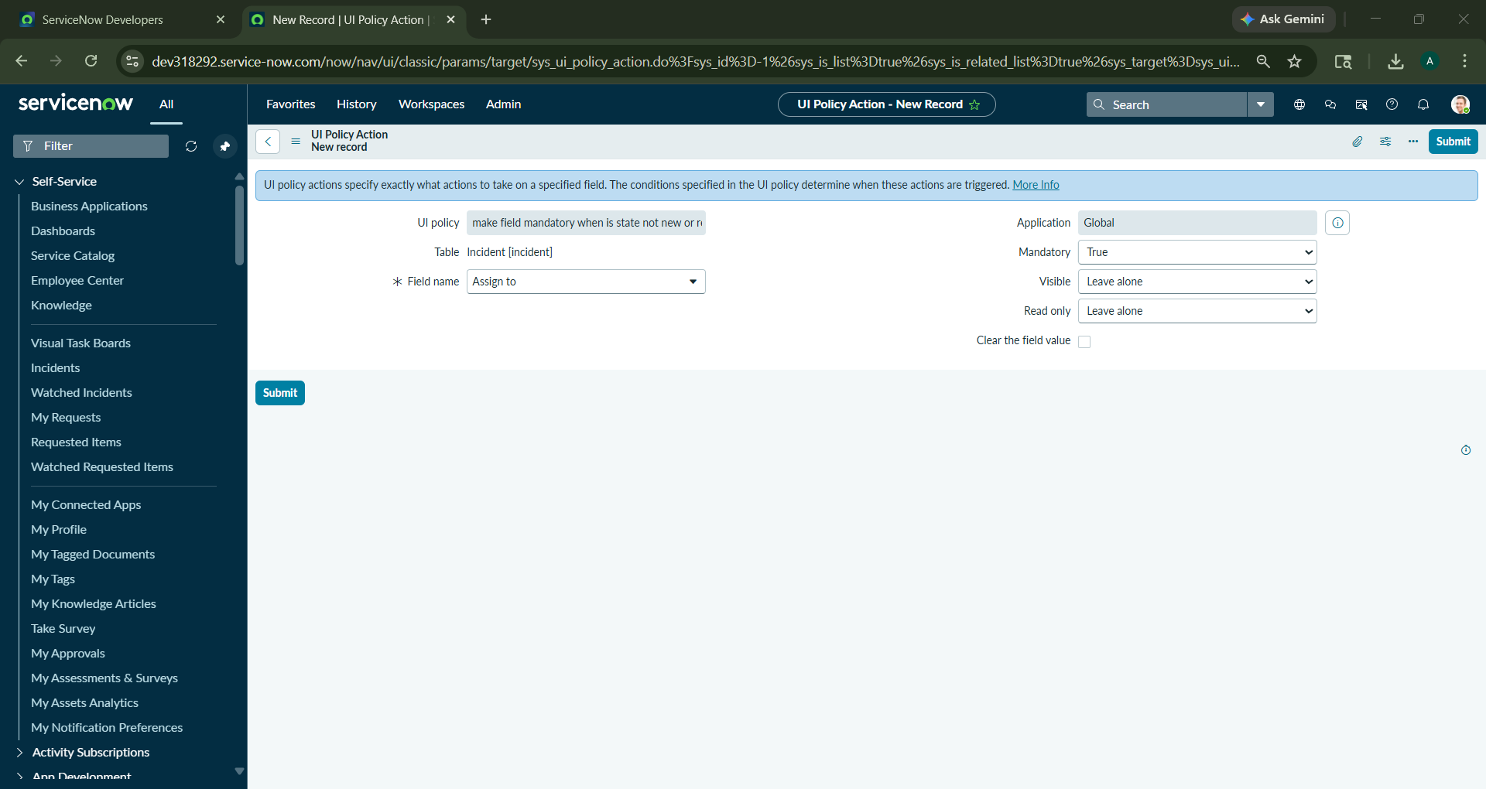
Step 6:Configuring a specific action for the 'Assigned to' field to set the 'Mandatory' attribute to 'True' when conditions are met.

Slide 7
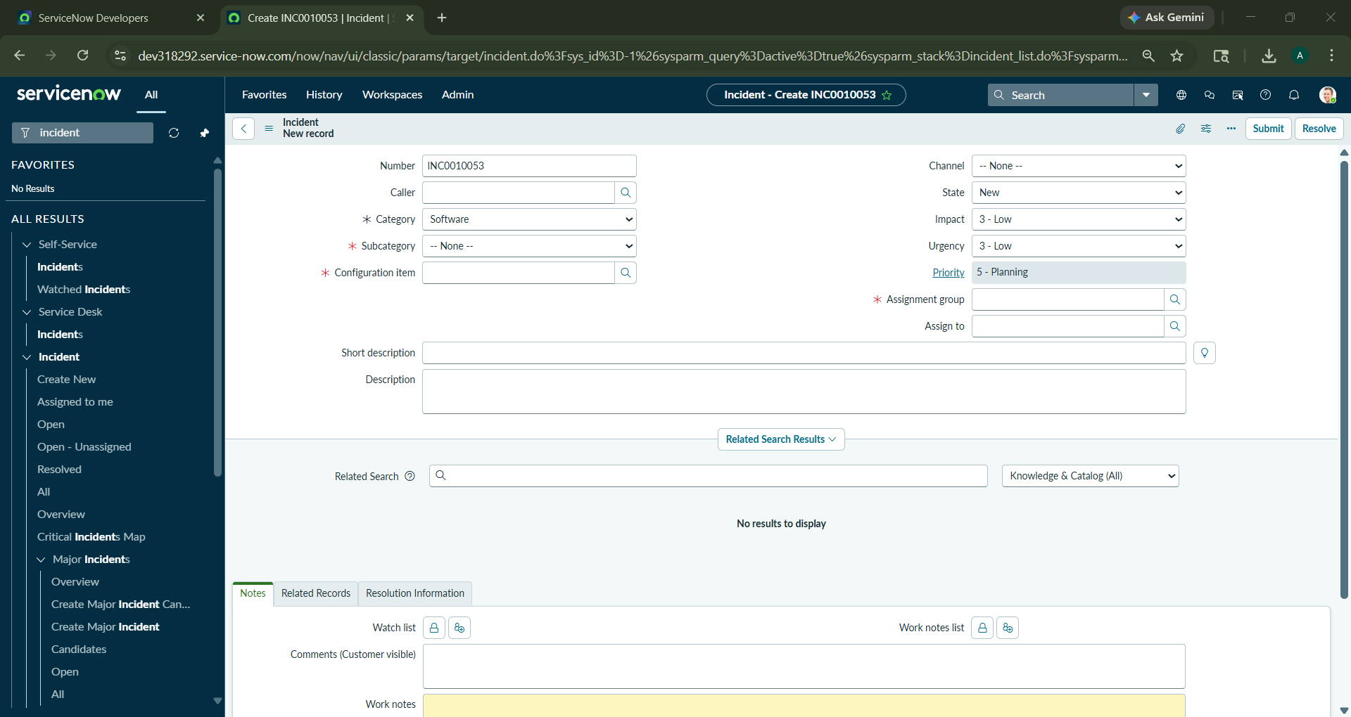

Step 8 : Scenario A: When State is 'New', 'Assigned to' remains optional. Scenario B: When State changes to 'In Progress', 'Assigned to' becomes a mandatory field.

